Slide 1
Green Roofs in Seattle
A Survey of Vegetated Roofs and Rooftop Gardens II

Slide 2
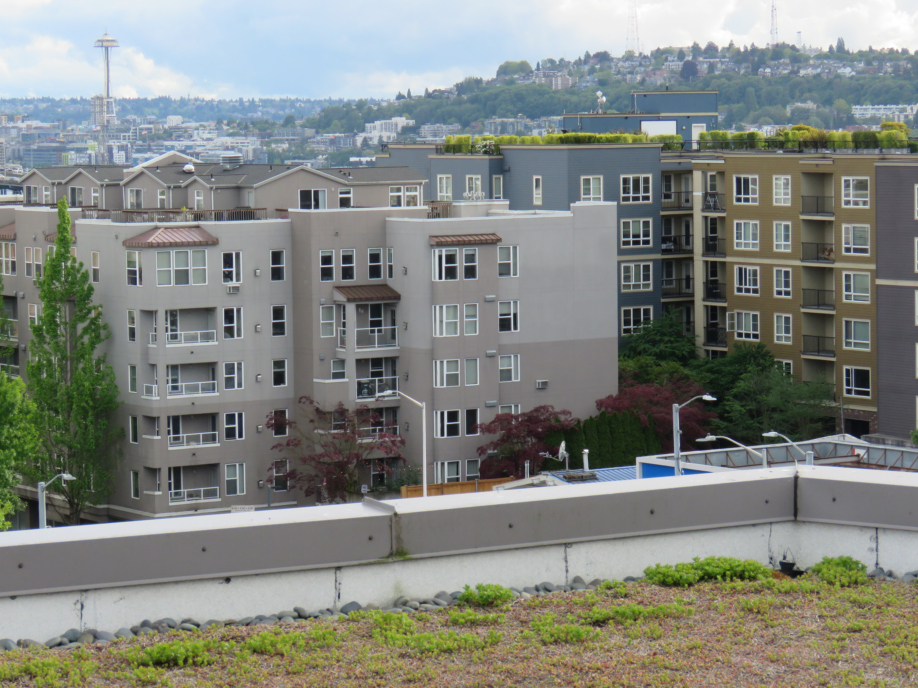
Introduction
What is a green roof?
“A green roof is a rooftop that is partially or completely covered with a growing medium and vegetation planted over a waterproofing membrane. It may also include additional layers such as a root barrier and drainage and irrigation systems.”
Rodriguez Droguett, B. (2011).
Sustainability assessment of green infrastructure
practices for stormwater management: A comparative
energy analysis

Slide 3
The green roof survey
Annika McIntosh in Green Futures Lab
Published in August 2010
Number of green roofs
Total square feet
Type (extensive or intensive)
Year built
Much more
McIntosh, Annika (2010) Green Roofs in Seattle: A Survey of Vegetated Roofs and Rooftop Gardens.

Slide 4
Context
History
Ecological benefits
Improved health
Urban heat island effect
Infrastructure

Slide 5
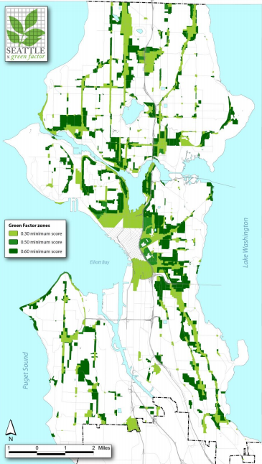
Seattle Green Factor
Applies to new development in certain zones
Commercial & neighborhood commercial
Industrial commercial
South downtown
Multifamily residential
South Lake Union
Seattle mixed
LaClergue, Dave (2013) Seattle Green Factor: Improving Livability and Ecological Function through Landscaping Standard.s

Slide 6
Seattle Green Factor
Minimum scores of
0.30
0.50
0.60
Points given for
(Landscape element) x (square feet)
Intensive green roof defined as 4” or greater
LaClergue, Dave (2013) Seattle Green Factor: Improving Livability and Ecological Function through Landscaping Standard.s

Slide 7
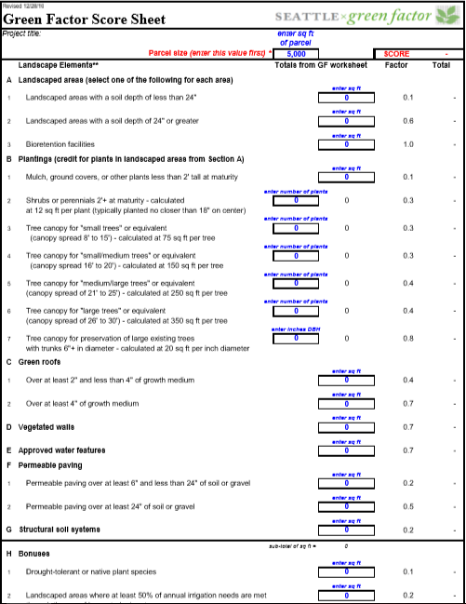
Total square feet of landscape element
Factor (weighted multiplier)
Score for landscape element
Totals / total square feet
= Overall score

Slide 8
Process
Getting connected
Research
Organizing data

Slide 9
Process
Getting connected
Research
Organizing data
Annika McIntosh – 2009 survey
Vera Giampietro – City of Seattle
Pam Emerson – Seattle Public Utilities

Slide 10
Process
Getting connected
Research
Organizing data
Seattle Green Factor scoresheet
Green roof questionnaire
Aerial satellite imagery

Slide 11
Research
Application
Number

Slide 12
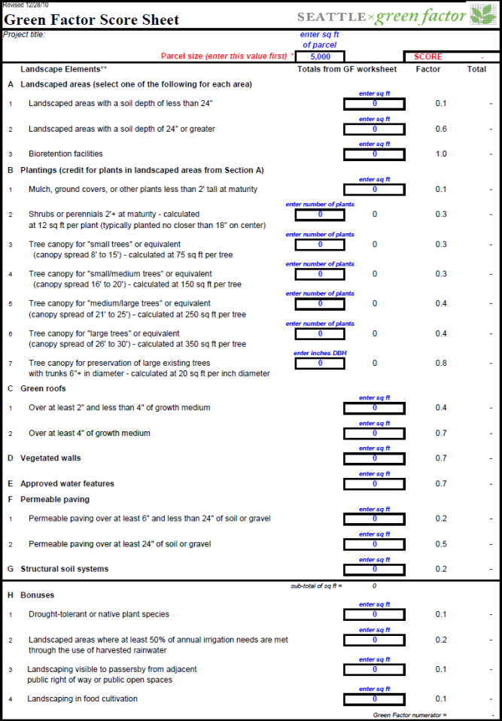

Slide 14
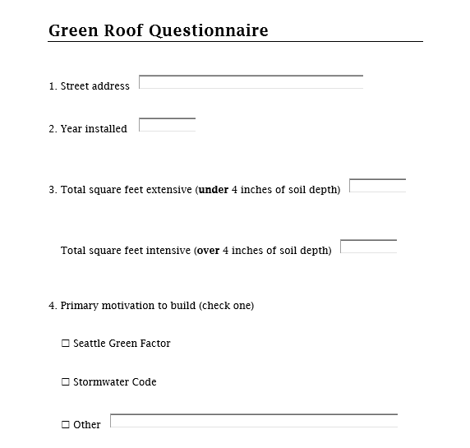
Research

Slide 15
Process
Getting connected
Research
Organizing data

Slide 16
Process
Getting connected
Research
Organizing data
Green roof types
Green roofs built by year
Motivation to build

Slide 17
Organizing data
Excel document
Application number
Date approved
Address
Green roof type (extensive or intensive)
Square feet
Contact information
Motivation to build
Year built

Slide 18
Results

Slide 20
2009 survey
2018 survey

Slide 21
Next Steps
Complete research
Seattle Green Factor scoresheets
Green roof questionnaire
Results
Organize data
Results to City of Seattle and Seattle Public Utilities
Write a report
Aerial maps

Slide 22
Implications
Possible modification or expansion of Seattle Green Factor standards
Provides data for GIS layer
Data can be used for various other studies
Insight into developer’s motivation to build green roofs

Slide 23
Thank you!

